Slide 1
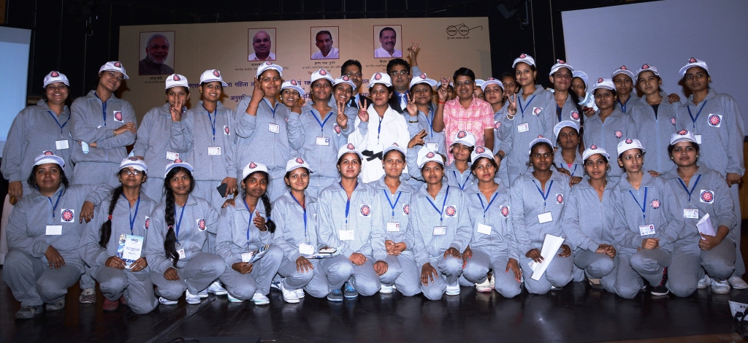

Enter Username
Enter Password
Forgot Password?
Login

Slide 2





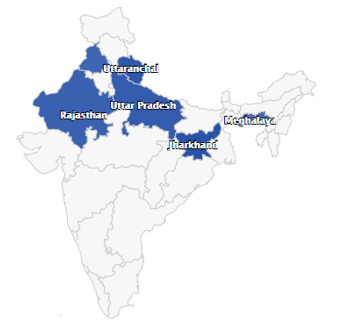






Praveen Saxena
Logout
55
2500
80
10
Dashboard
Ongoing Trainings
Candidates Trained
Training Partners
Upcoming Assessments
Data Import
Manage Assessments
Number of Training Partners in each state
FAQ
Generate Reports
Generate Certificates

Slide 3

Praveen Saxena
Logout
Import
Import
Dashboard
Data Import
Batch
Upload .CSV File Here
Browse
Upload
Manage Assessments
FAQ
Import History
Generate Reports
File Name | Type | Date | Uploaded By | View Uploaded File
File Name | Type | Uploaded On | Uploaded By | View Uploaded File
Batch 2017 | Batch | 23-03-2017 | Kamal Saxena
Generate Certificates

Slide 4
Praveen Saxena
Logout
Dashboard
Non – Assessed Batches
Data Import
Batch ID | Location | End Date | Assessment Date | Assessment Status
Manage Assessments
FAQ
Assessed Batches
Generate Reports
Generate Certificates
Batch ID | Location | End Date | Assessment Date | Assessment Status
Search Batches
Enter Batch Id
Search
Batch ID | Location | End Date | Assessment Date | Assessment Status
Notes:
The system will send an email to the admin of the application when the assessment date approaches

Slide 5

Praveen Saxena
Logout
Dashboard
Frequently Asked Questions
Data Import
How many Candidates have been trained from to in the year ?
Manage Assessments
January
March
2018
FAQ
Generate Reports
How many Candidates have been trained from to in the year ?
Generate Certificates
January
March
2018
How many Candidates have been trained from to in the year ?
January
March
2018

Slide 6

Praveen Saxena
Logout
Dashboard
Frequently Asked Questions
Data Import
How many Candidates have been trained from to in the year ?
Manage Assessments
January
March
2018
FAQ
Month | Number of Candidates Trained
January to March | 265
Generate Reports
Generate Certificates
How many Candidates have been trained from to in the year ?
January
March
2018

Slide 7
Praveen Saxena
Logout
Dashboard
Generate Reports
Data Import
Assessment
Generate Report
Manage Assessments
FAQ
Generate Reports
Report History
Generate Certificates
Report ID | Report Type | Generated On | Generated By | View Report
BDC-264 | Safai Karamchari Assessment | 26-03-2018 | Kamal Saxena
Search Report
Enter Report Id
Search
Report ID | Report Type | Generated On | Generated By | View Report

Slide 8
Praveen Saxena
Logout
Dashboard
Generate Certificates
Data Import
Training Partner
Generate Certificates
Manage Assessments
FAQ
Generate Reports
Certificate Generation History
Generate Certificates
Sr. No. | Certificate Type | Generated On | Generated By | View Certificate
1 | Training Completion Certificate | 26-03-2018 | Kamal Saxena

